Slide 1
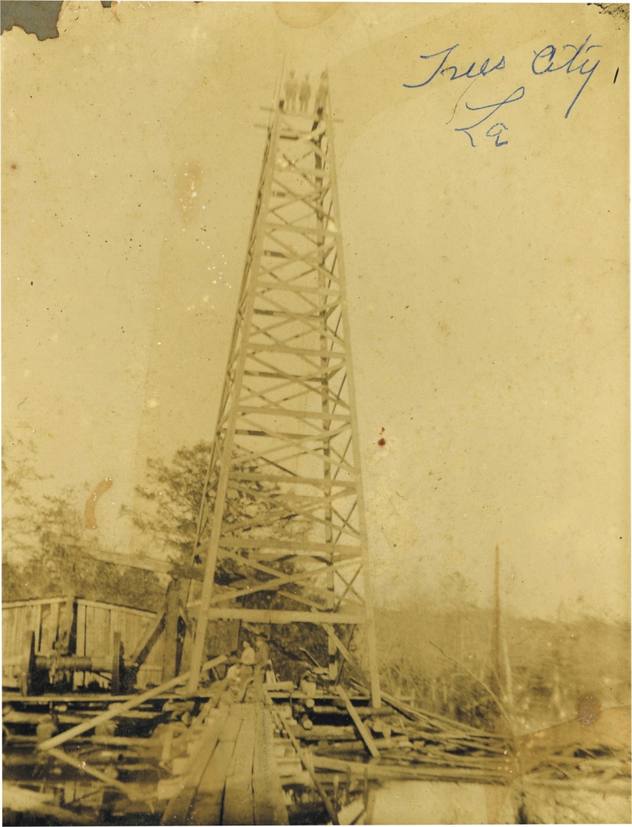
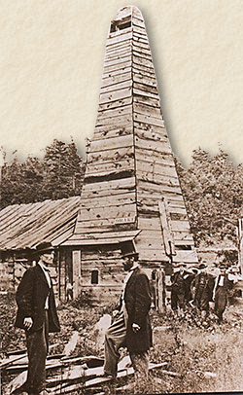
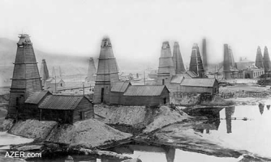
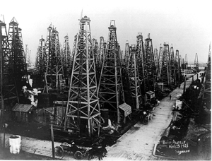
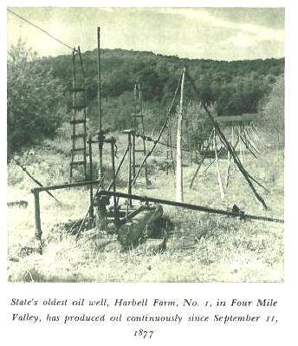
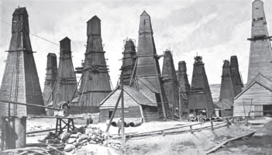
Oil & Gas
EG5066 Energy Technologies: current issues & future directions

Slide 2

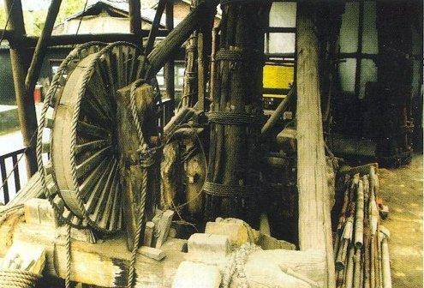
History of Petroleum
Asphalt used in the construction of Babylon
Oil exploited by the Romans in Dacia (Romania) when it was known as picula
Earliest oil wells in China 347CE
240m deep – drilled with bits attached to bamboo poles
China & Japan used natural gas for light and heat
Petroleum was known as “burning water” in 7thCentury Japan
Babylon
Early Chinese drilling equipment
EG5066 Energy Technologies: current issues & future directions

Slide 3

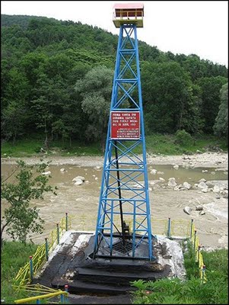
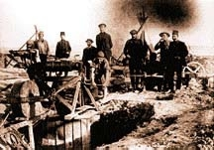
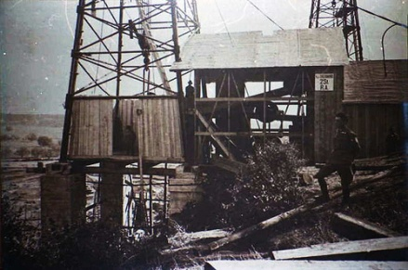
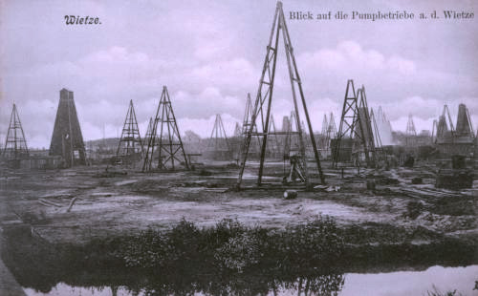
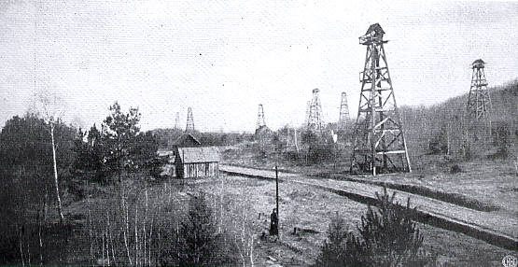
History of Petroleum
Oils fields around Baku were first exploited in the 9th Century
1860s Baku produced 90% of World’s oil
First modern Russian oil refinery 1861
Petroleum first distilled to kerosene for lamps by Persian alchemist Rhazes in the 9th Century
First commercial oil well in Romania drilled in 1857
First country to record crude oil output
First large oil refinery at Ploesti, Romania on 1856-57
First oil sands mined 1745 in Alsace, France – active until 1970
First “rock oil” mine built in Bobrka (Poland/Ukraine) in 1853
First Romanian oil well
Baku
Ploiesti, Romania 1916
Pechelbronn
Bobrka oil field, Poland/Ukraine
EG5066 Energy Technologies: current issues & future directions

Slide 4
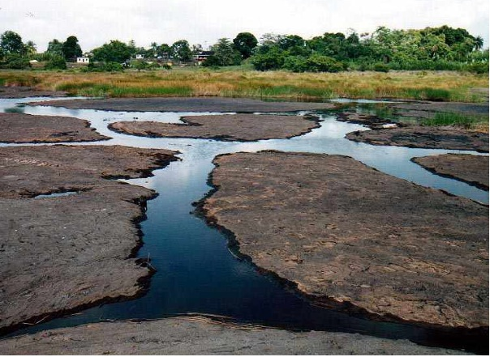
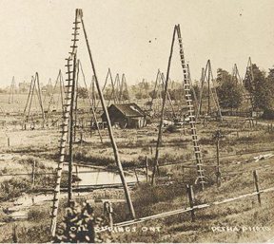
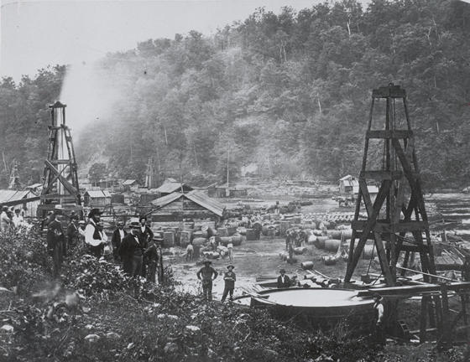
History of Petroleum
First record – Sir Walter Raleigh – Trinidad Pitch lake (1595)
First North American oil well – 1858 at Oil Springs, Ontario, Canada
First US oil well – 1859 at Oil Creek, Titusville Pennsylvania
21 m deep
Start production 25 bpd – after 12 months down to 15bpd
Trinidad Pitch Lake
Oil Springs, Canada
Oil Creek - Drakes well
EG5066 Energy Technologies: current issues & future directions

Slide 5
History of Petroleum
Industry grew with demand for kerosene and oil lamps
And then came the ICE...... But coal still dominated until mid 1950s
Year | US Oil Production (bpd) |  | US Oil Production (bpd)
1860 | 1 | 1940 | 4107
1870 | 14 | 1950 | 5407
1880 | 72 | 1960 | 7035
1890 | 126 | 1970 | 9637
1900 | 174 | 1980 | 8597
1910 | 574 | 1990 | 7355
1920 | 1210 | 2000 | 5822
1930 | 2460 | 2010 | 5479
EG5066 Energy Technologies: current issues & future directions

Slide 6
Origins of Oil & Gas
Dominant view
Products of complex, gradual transformation of ancient accumulations of dead organic matter (zooplankton & algae) in anaerobic conditions
Russian-Ukrainian view
Abiogenic products formed under high temperatures and pressures deep in the earth’s mantle from which they rise to be trapped in porous structures near the earth’s surface
Organic matter
Kerogen
Catagenisis
Hydrocarbons
EG5066 Energy Technologies: current issues & future directions

Slide 7
Composition
Complex mixture of hydrocarbons
Ultimate elemental analysis
C = 85% (83-87)
H = 13% (1 – 15)
H/C ratio 1.8 cf 0.8 for bituminous coal, 4 for methane
Contains three main series of hydrocarbons
Alkanes (pentane, hexane) – aka paraffin
Cycloalkanes (cyclopentane, cyclohexane) – aka cycloparaffins
Arenes (benzene, toluene) – aka aromatics
Sulphur most common undesirable contaminant
“sour” oils have >2% S
“sweet” oils have < 0.5% S
EG5066 Energy Technologies: current issues & future directions

Slide 8
API
American Petroleum Institute gravity based on arbitrary assignment of 10 ºAPI to water
Conversion for specific density
ºAPI = (141.5/specific density g/ml) – 131.5
Oil | Specific density (g/ml) | ºAPI
Very heavy crude oil | 0.95 | 17.5
Light oil | 0.82 | 41
EG5066 Energy Technologies: current issues & future directions

Slide 9
API
Oil | ºAPI
Most Saudi crude oils | 28 - 33
Kuwait | 23
Iraqui (Basra) | 25
Alaska North Slope | 29
North Sea Brent | 38
Libyan, Algerian, Nigerian | 37 - 44
Australian Northwestern Shelf | 60
Price versus density
The lighter the oil (the higher the ºAPI) the higher the price
Barrel of oil
42 US Gallons/35 Imperial Gallons/159 litres
Adopted by US Bureau of the Census in 1872
bbl – blue barrel
Most oils 7.0 – 7.5 barrels/tonne
EG5066 Energy Technologies: current issues & future directions

Slide 10
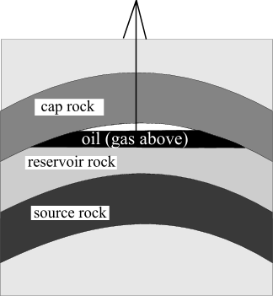
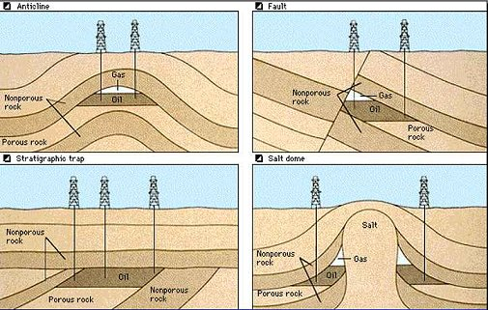
Oil & Gas Deposits
Commercially viable oil deposits have:
Rich source rocks
Permeable & porous reservoir rock
Tight trap to hold liquid/gas in place
Two types of reservoir rock:
Clastic
Carbonate
Traps
Anticline – 4/5 of world’s largest reservoirs
Fault
Salt dome – world’s 2nd largest oil field is of this type
Stratigraphic – contains elongated sandstone structures
EG5066 Energy Technologies: current issues & future directions

Slide 11
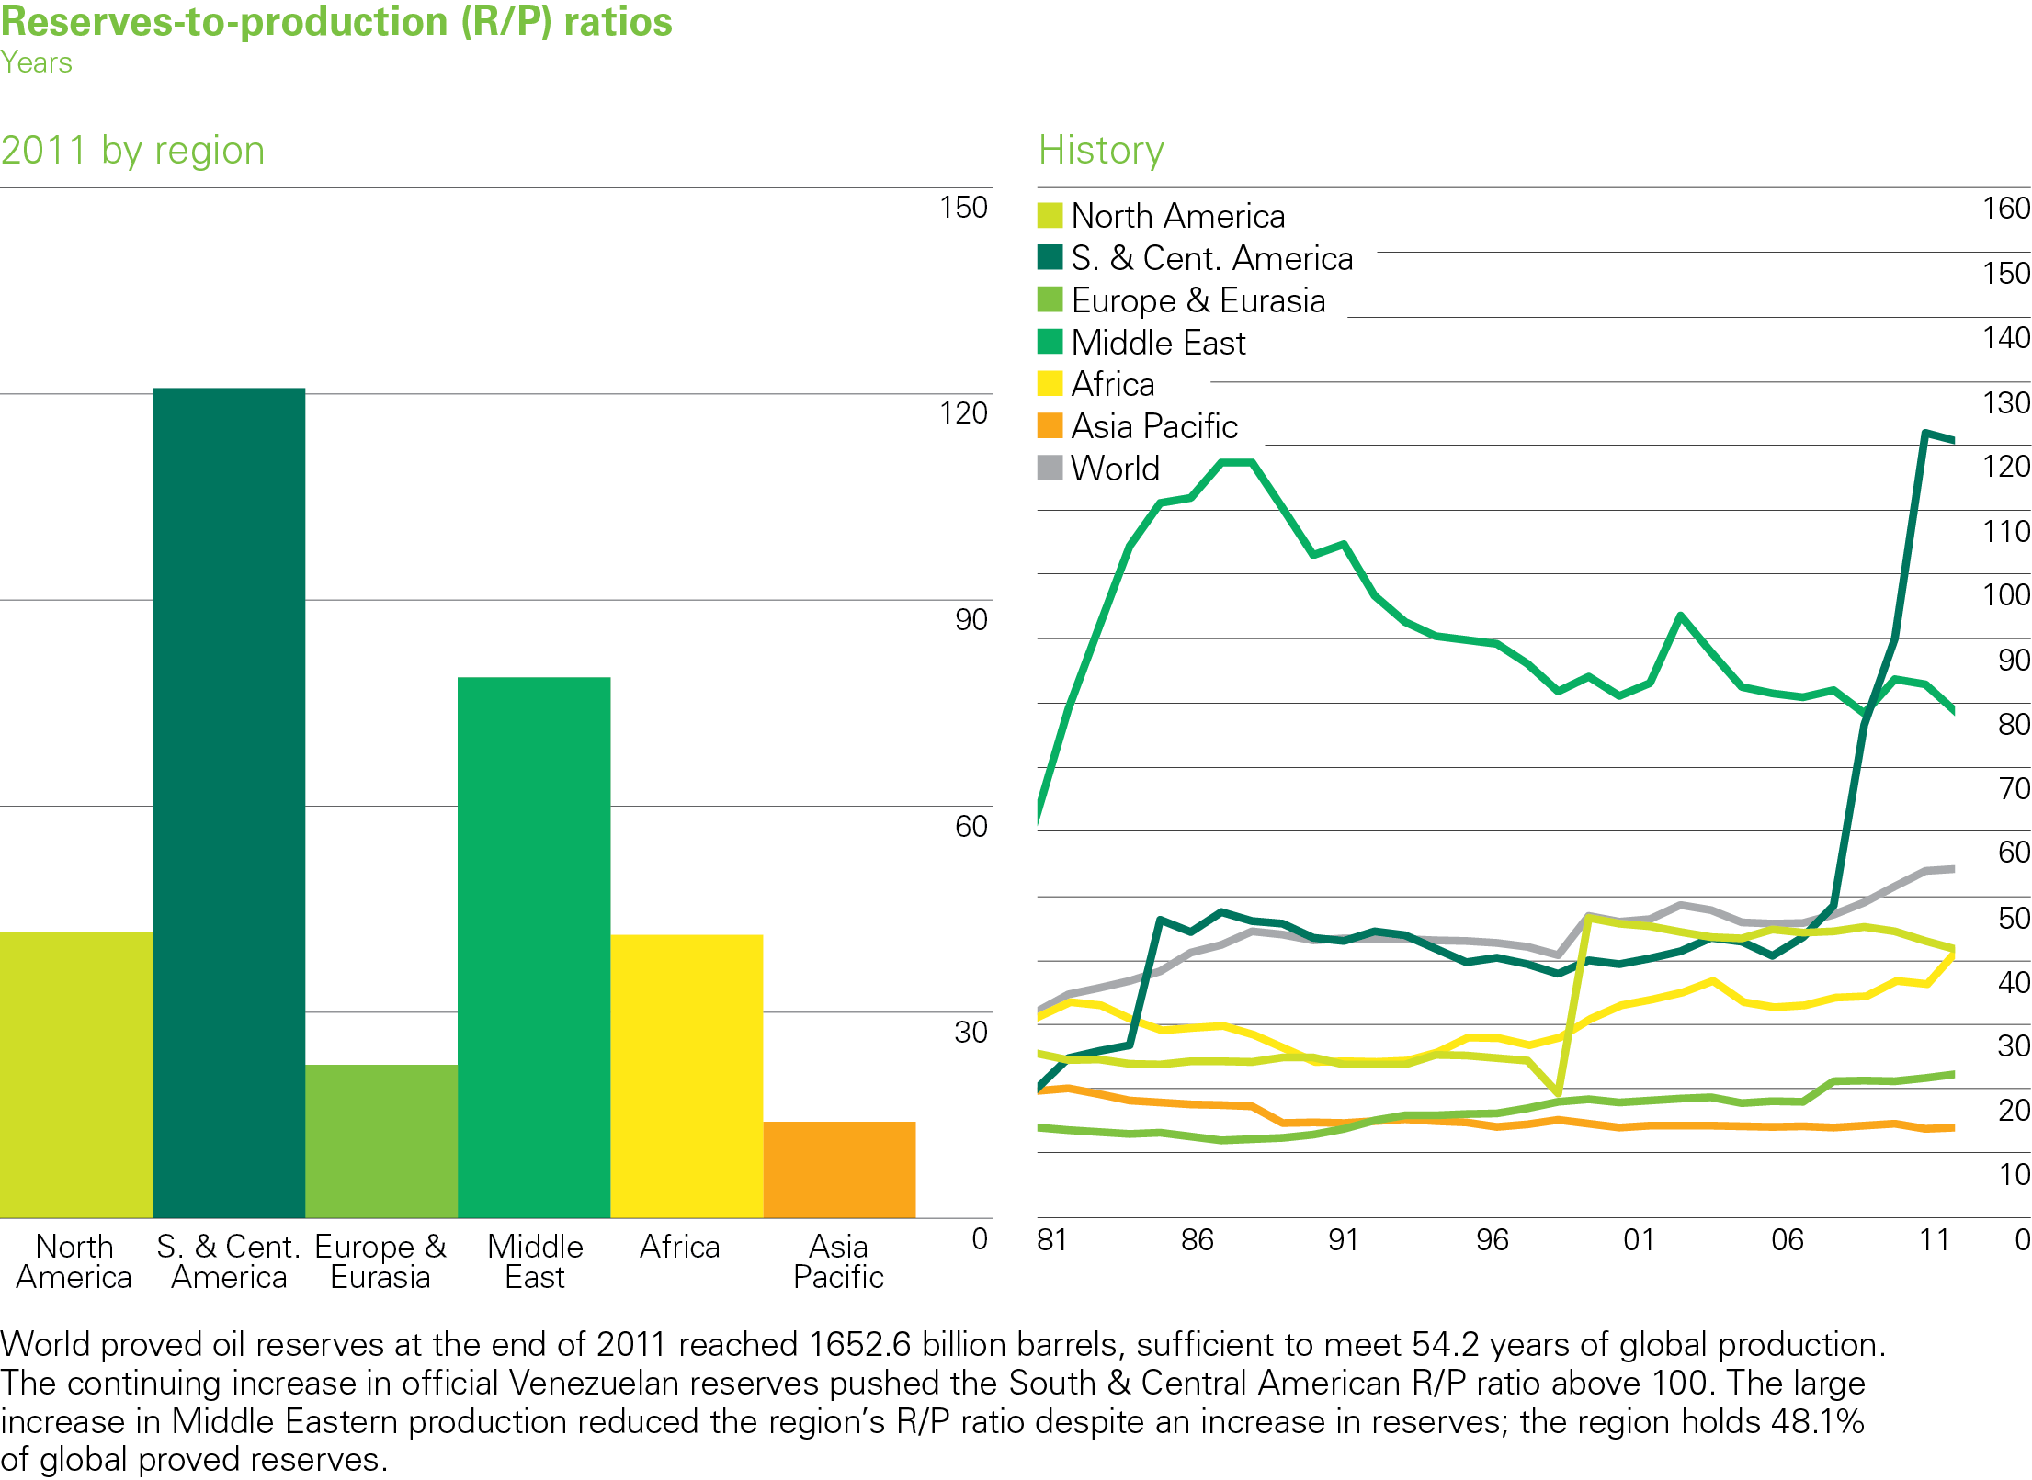
Oil reserves-to-production (R/P) ratios
EG5066 Energy Technologies: current issues & future directions

Slide 12
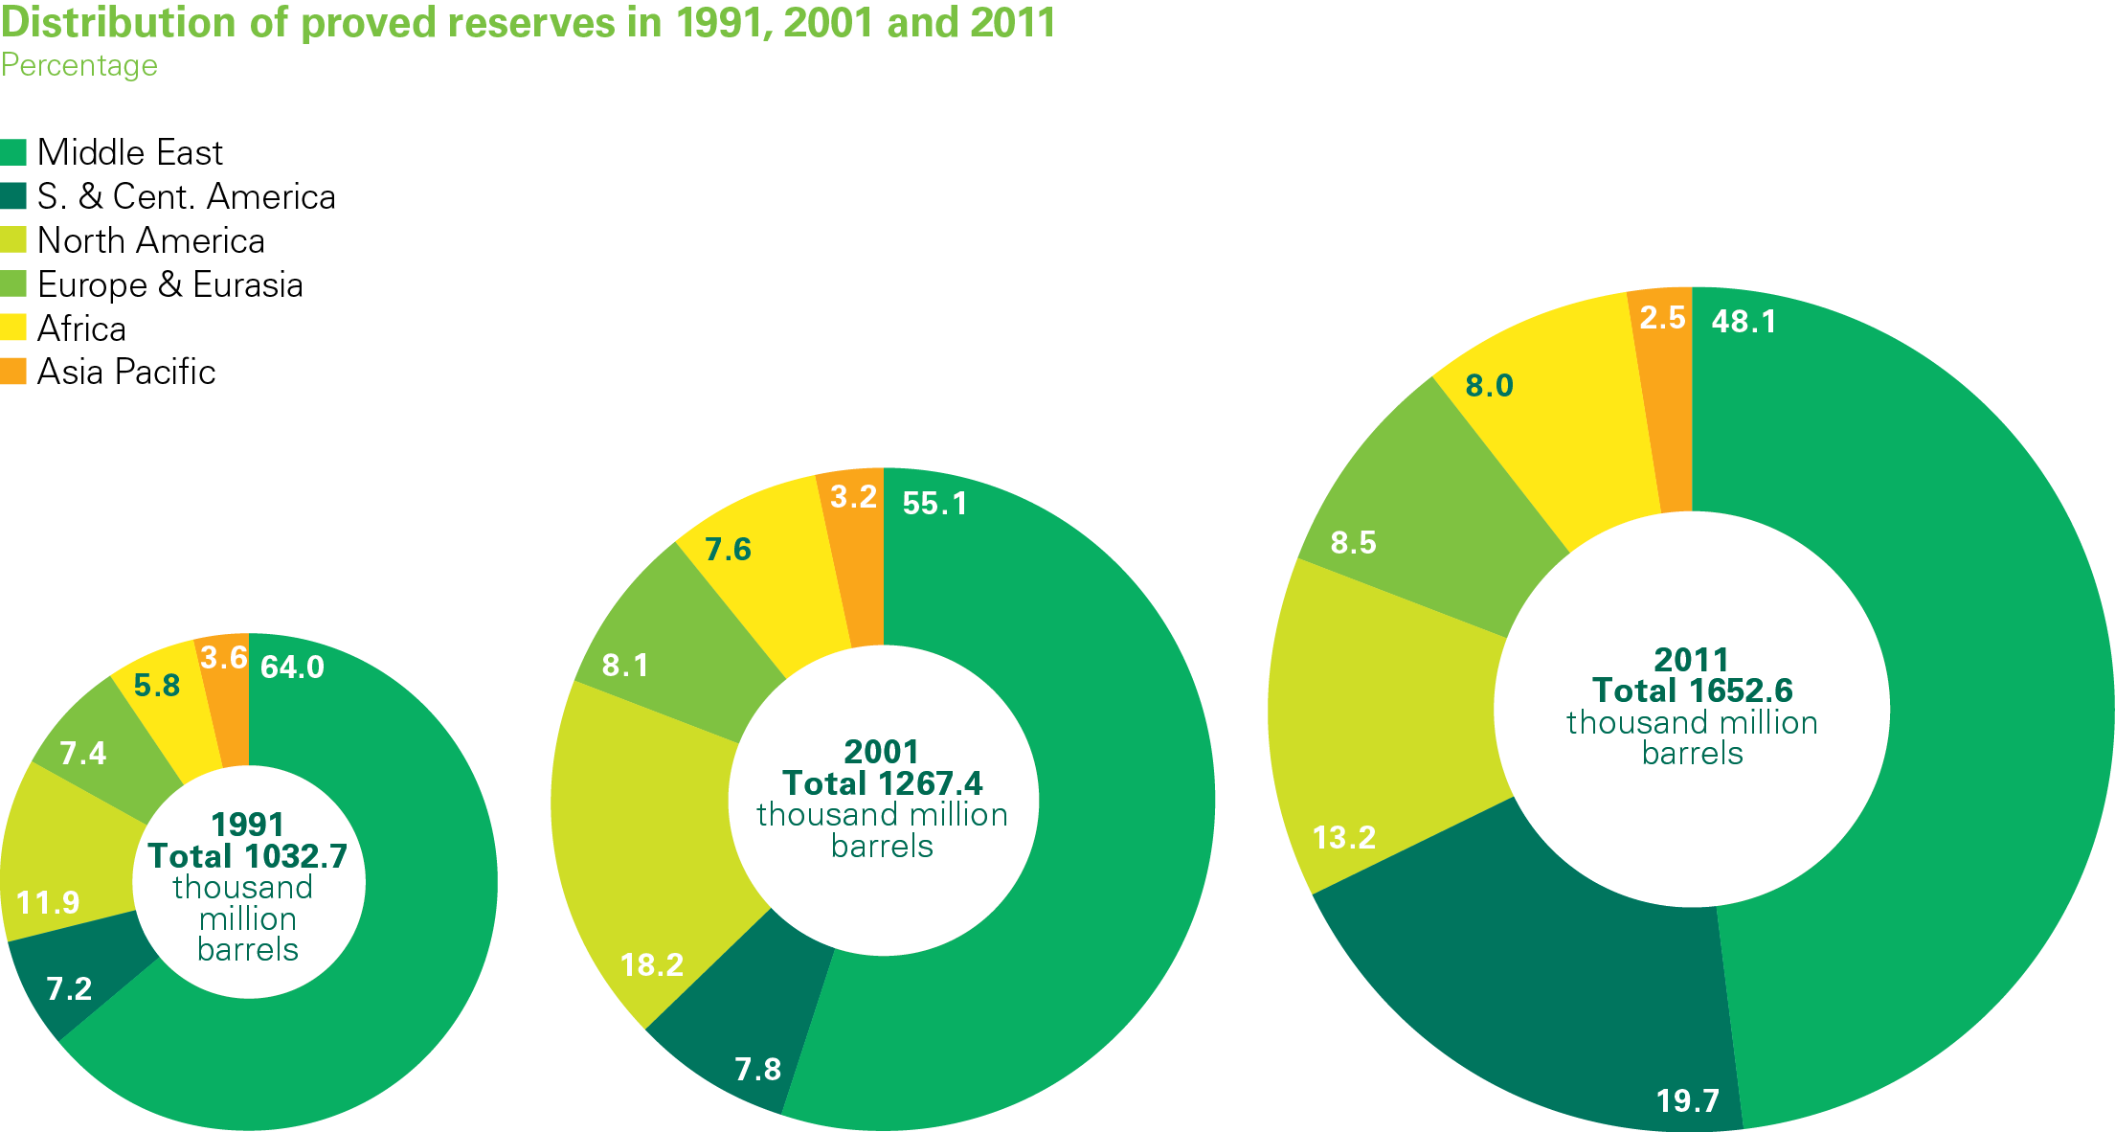
Distribution of proved oil reserves
EG5066 Energy Technologies: current issues & future directions

Slide 13
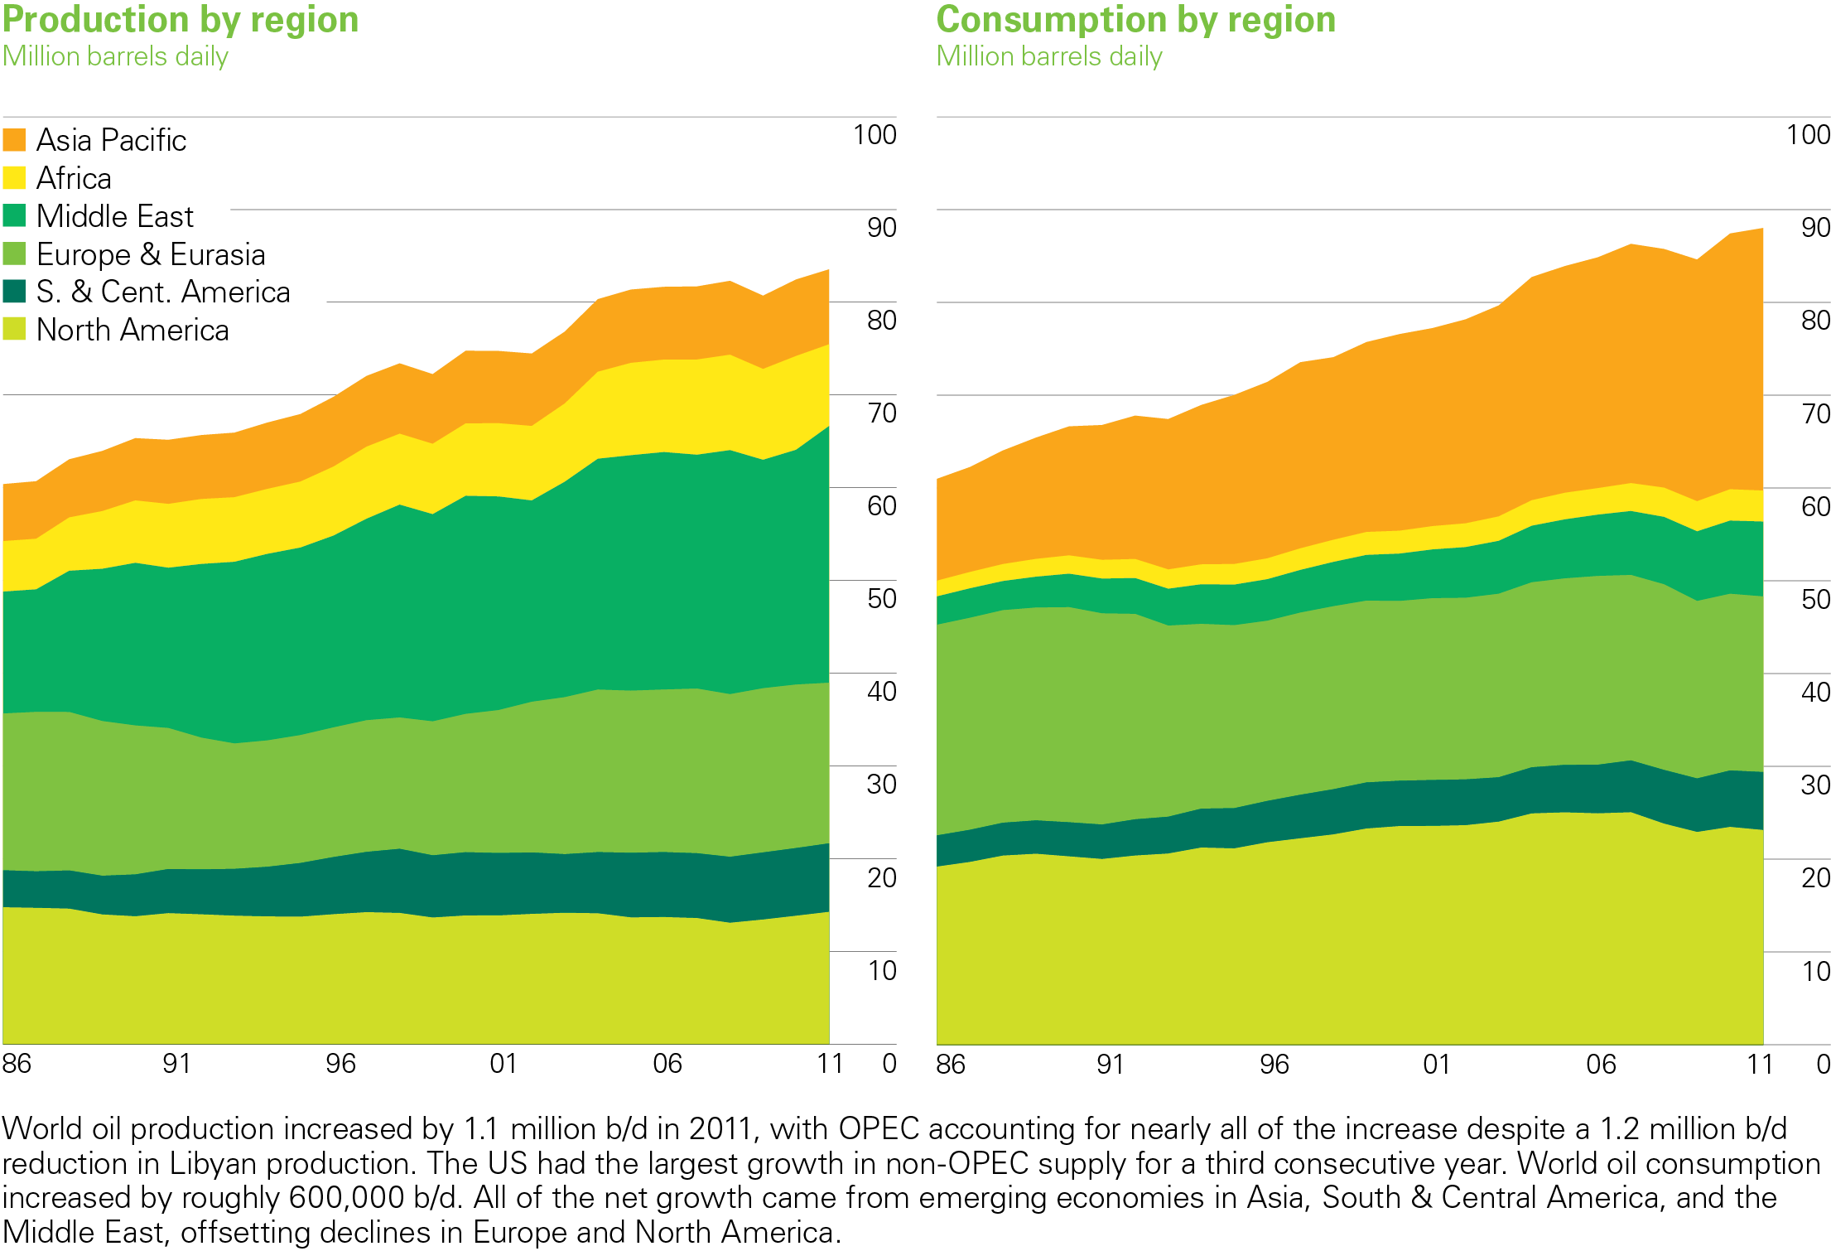
Oil production/consumption by region 2011
BP Statistical Review of World Energy 2012
© BP 2012
EG5066 Energy Technologies: current issues & future directions

Slide 14
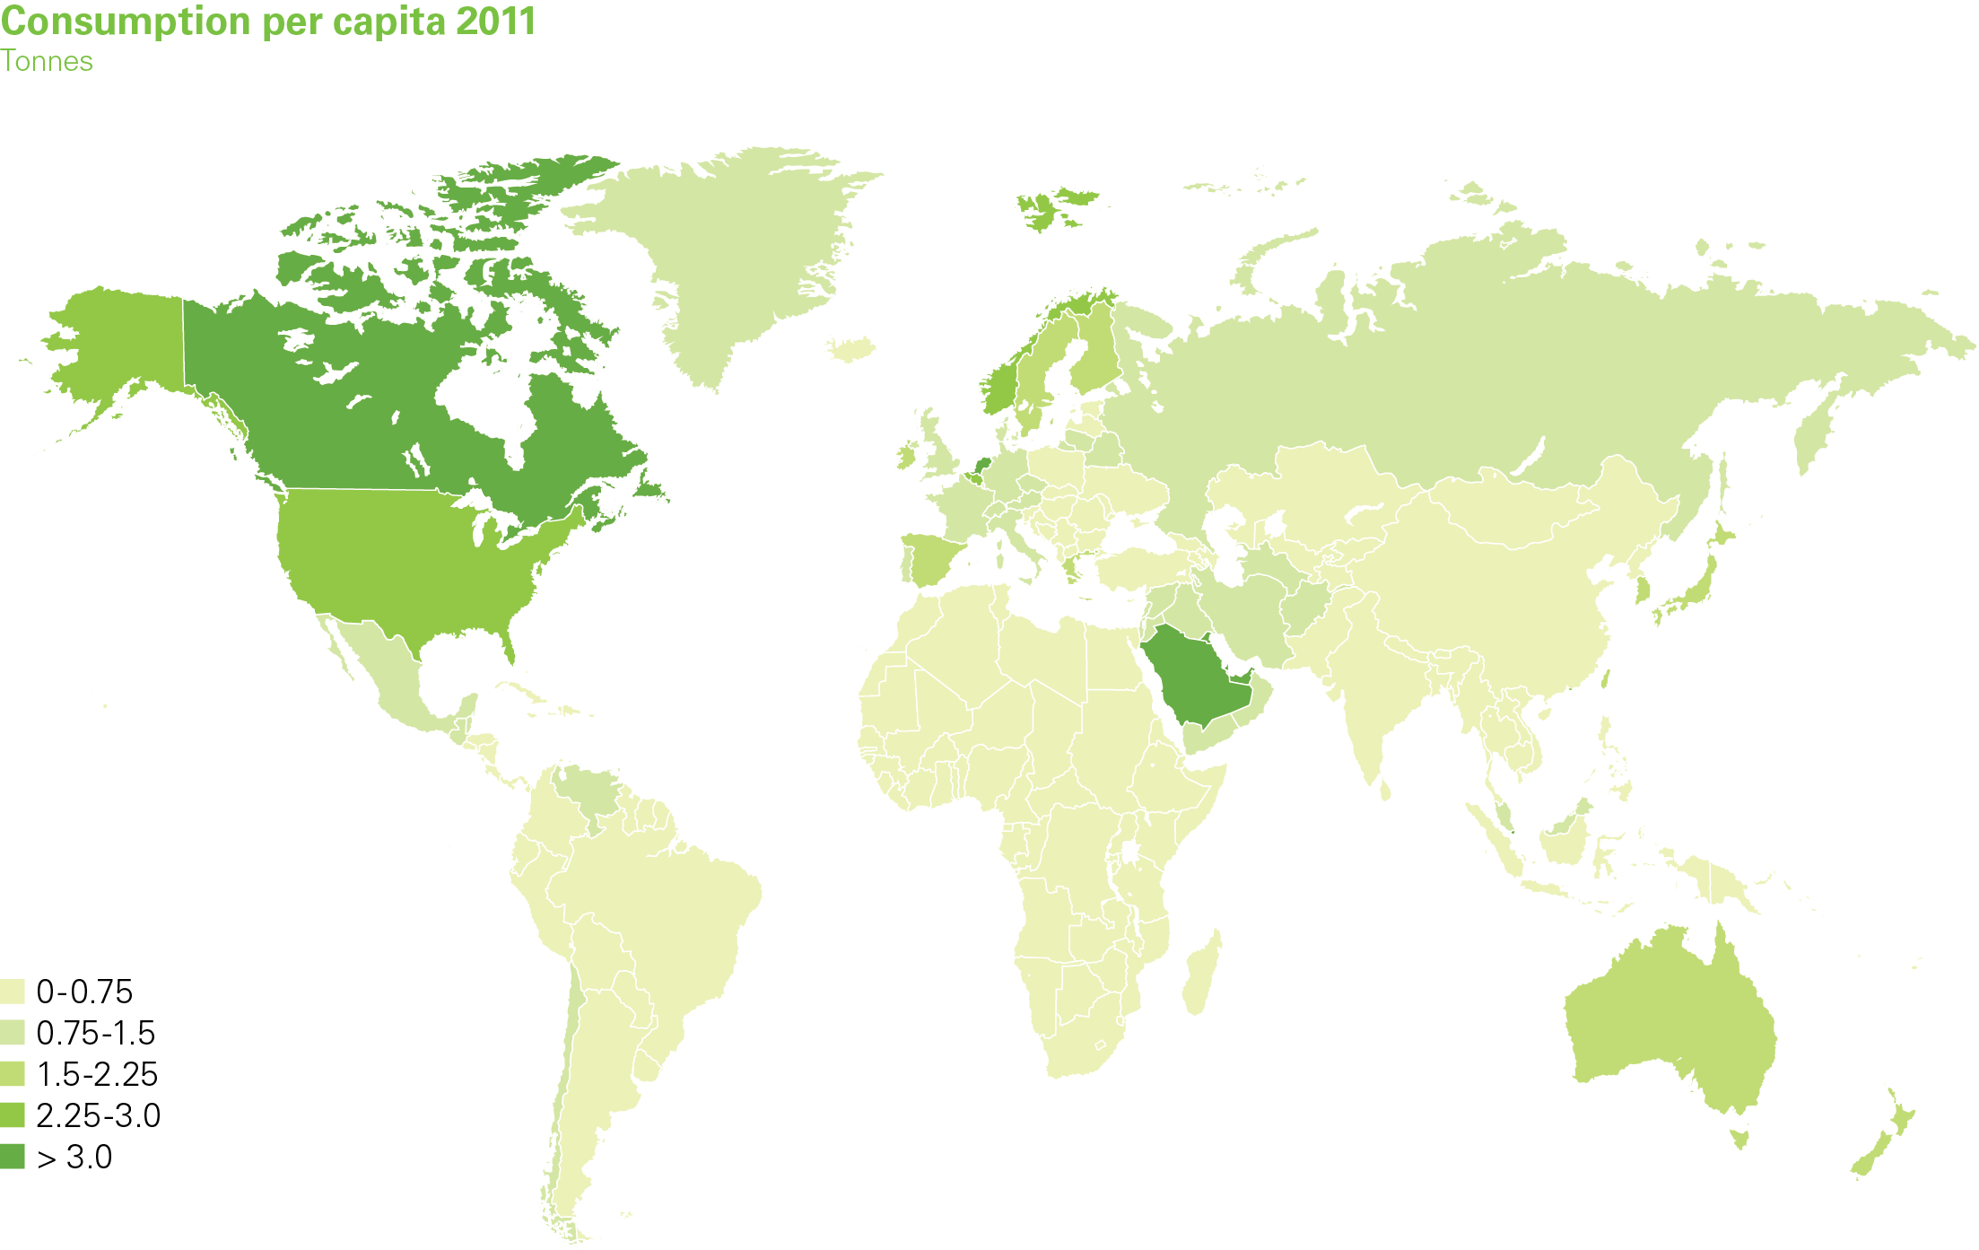
Oil consumption per capita 2011
BP Statistical Review of World Energy 2012
© BP 2012
EG5066 Energy Technologies: current issues & future directions

Slide 15
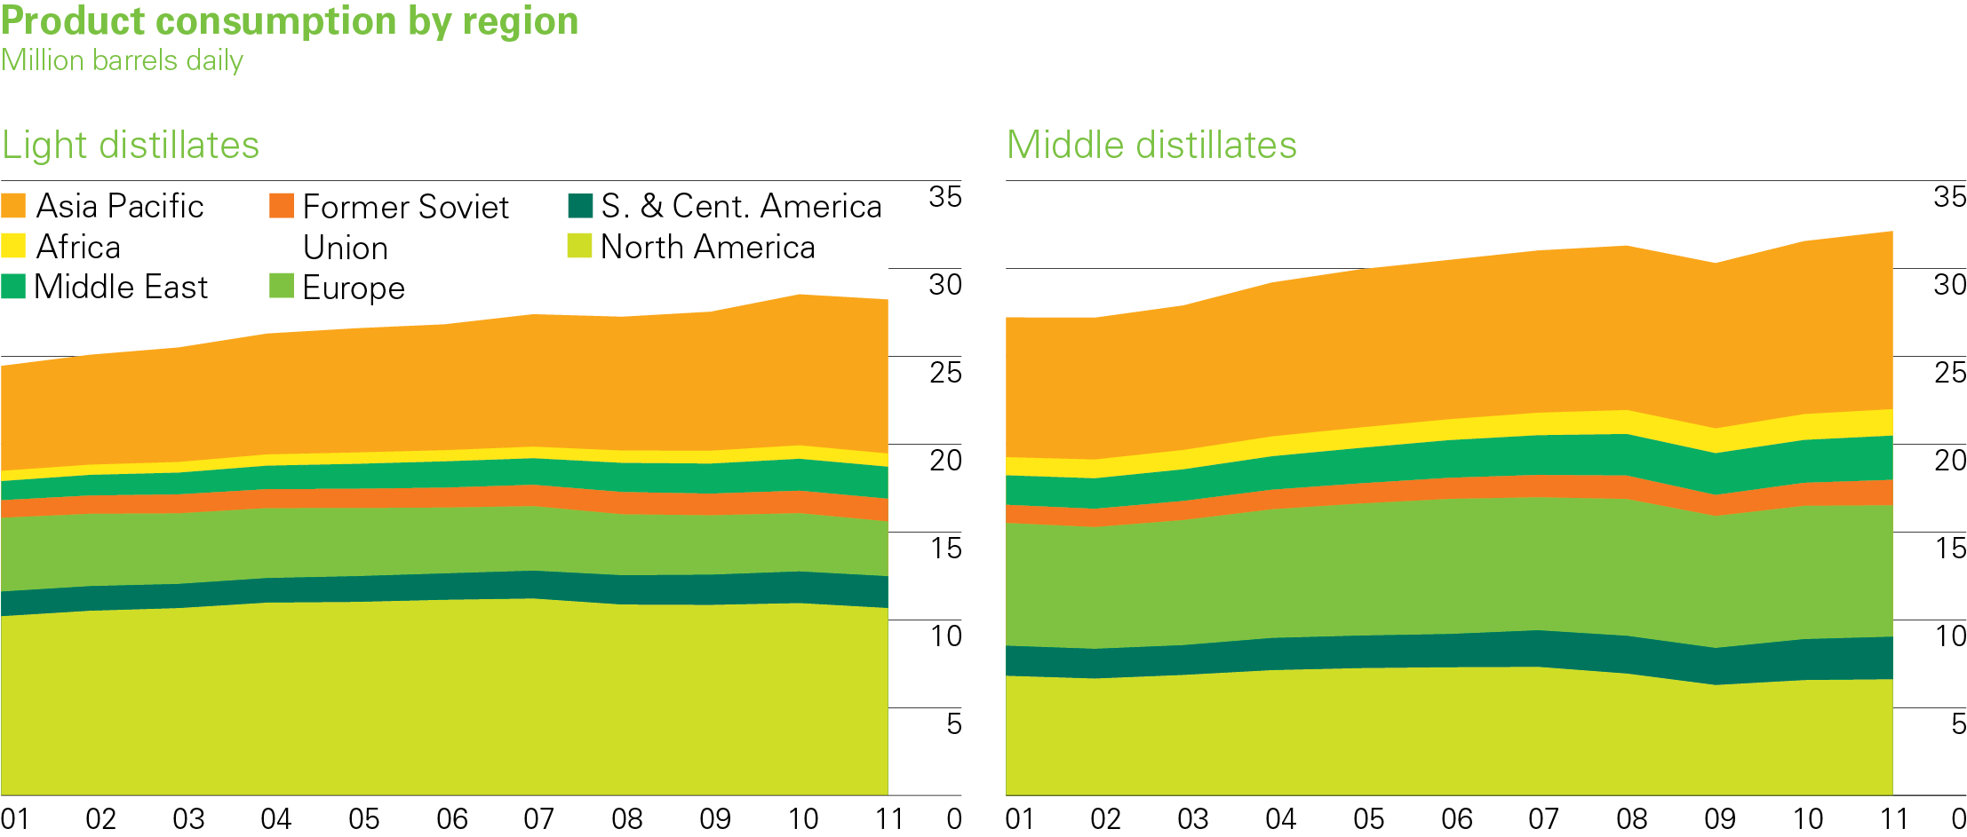
Oil product consumption by region
EG5066 Energy Technologies: current issues & future directions

Slide 16
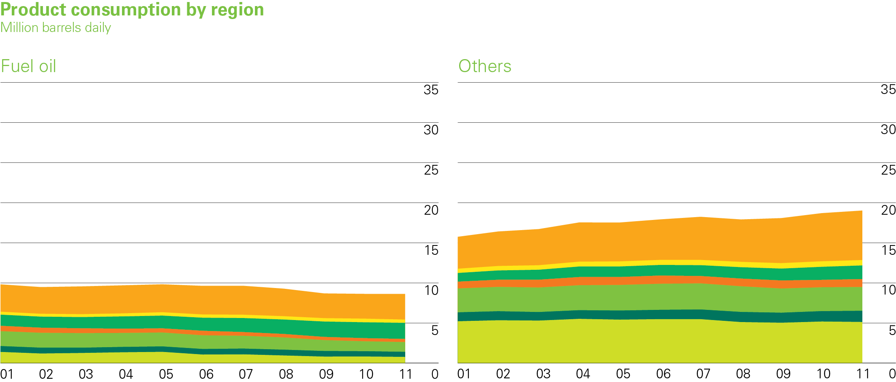
Oil product consumption by region
EG5066 Energy Technologies: current issues & future directions

Slide 17
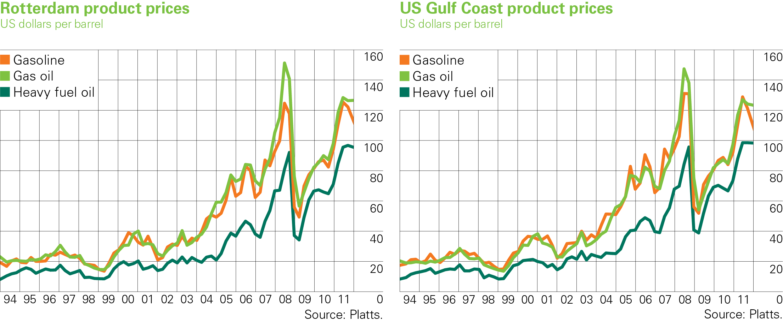
Chart of Rotterdam & Gulf Coast product prices
EG5066 Energy Technologies: current issues & future directions

Slide 18
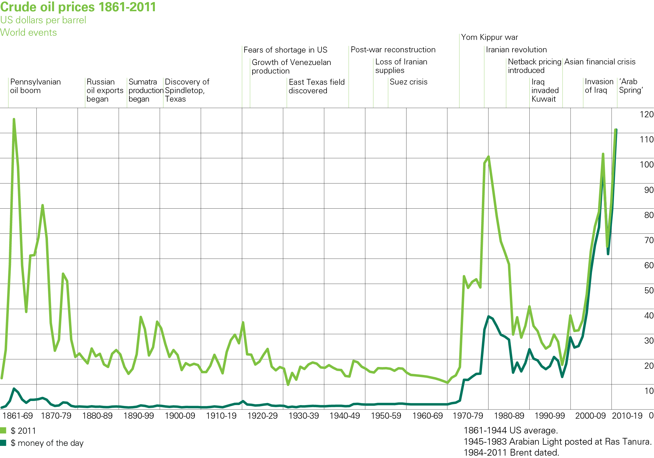
Chart of crude oil prices since 1861
EG5066 Energy Technologies: current issues & future directions

Slide 19
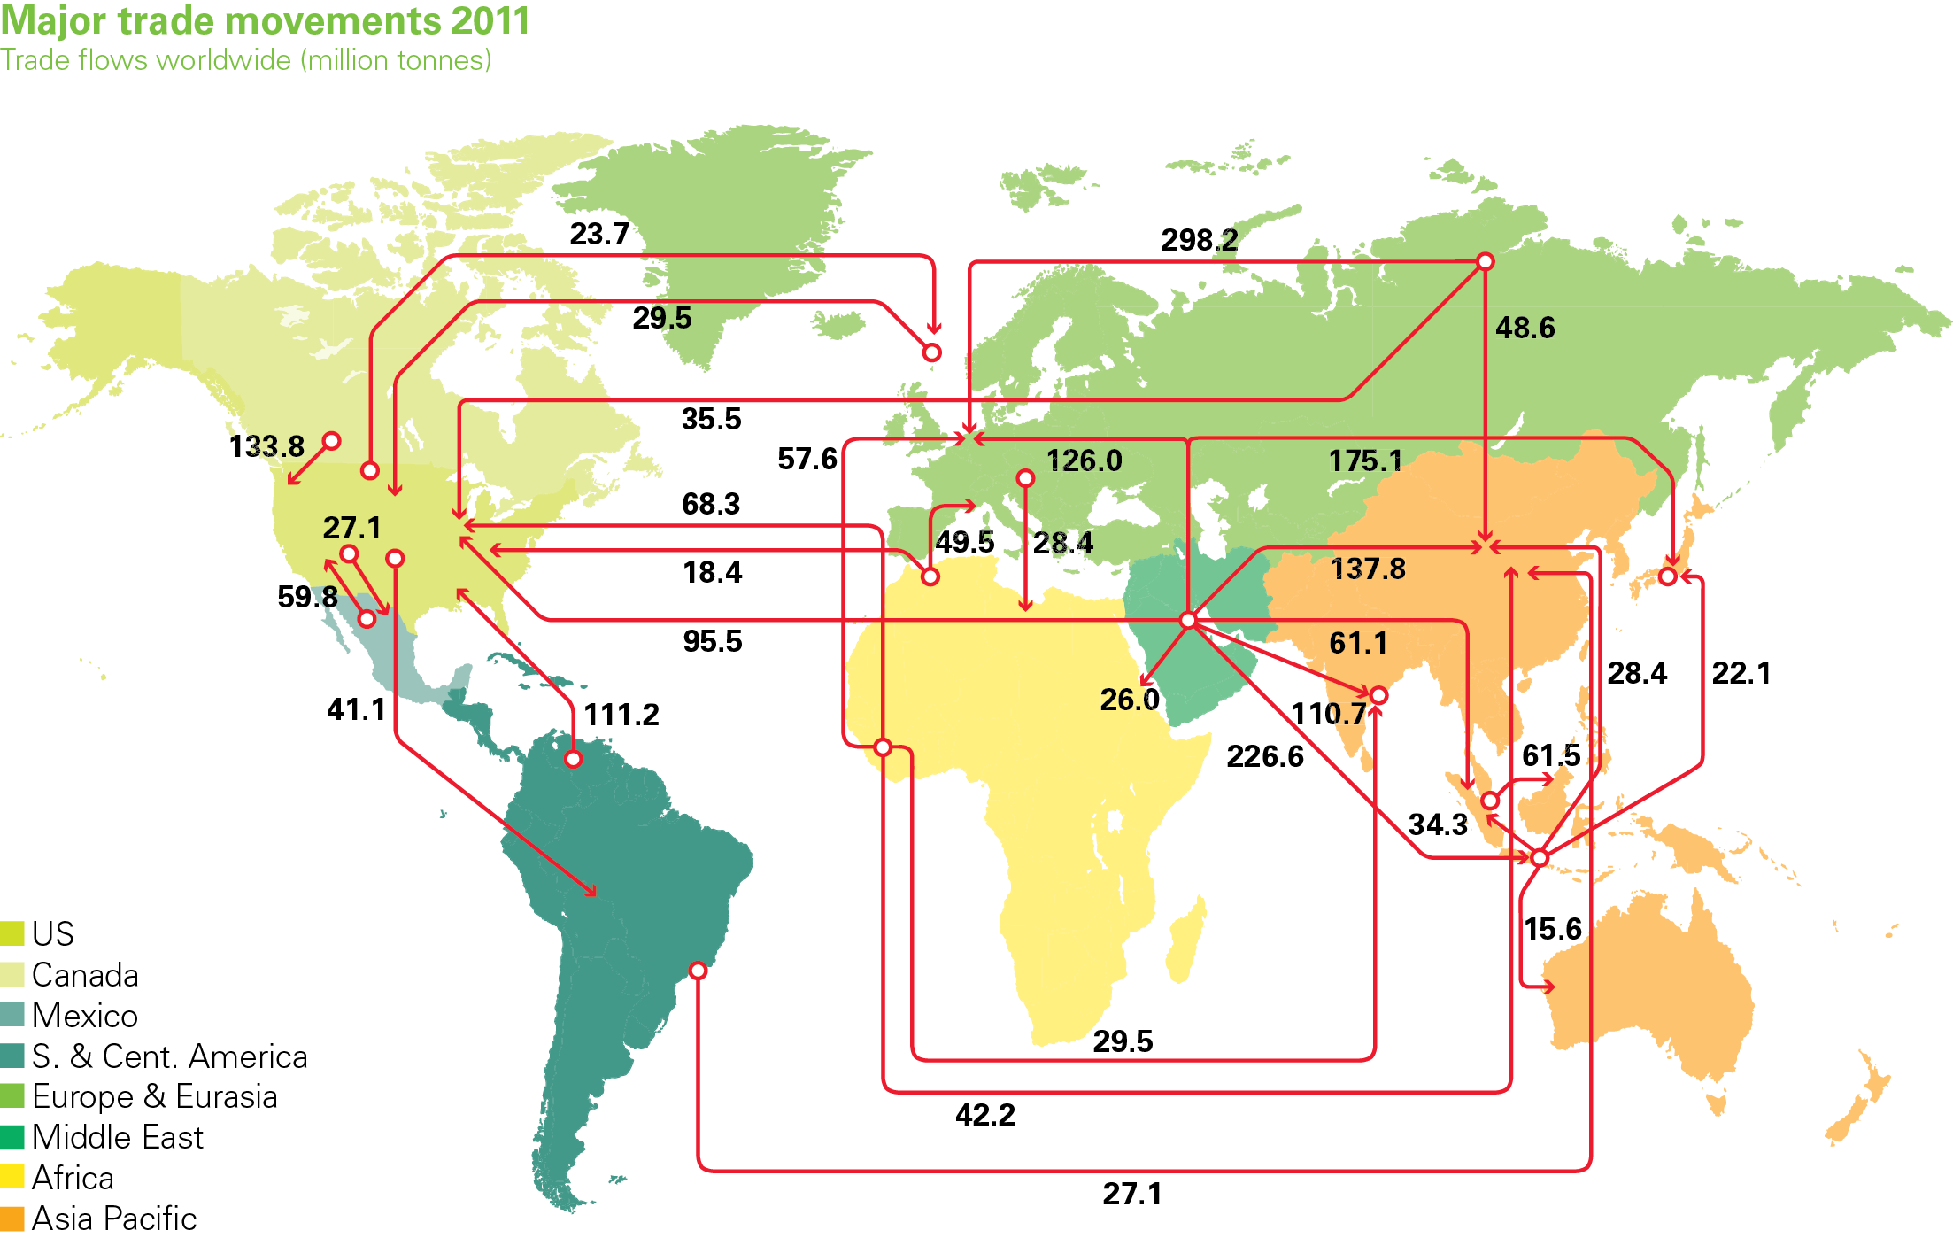
Major oil trade movements
EG5066 Energy Technologies: current issues & future directions

Slide 20
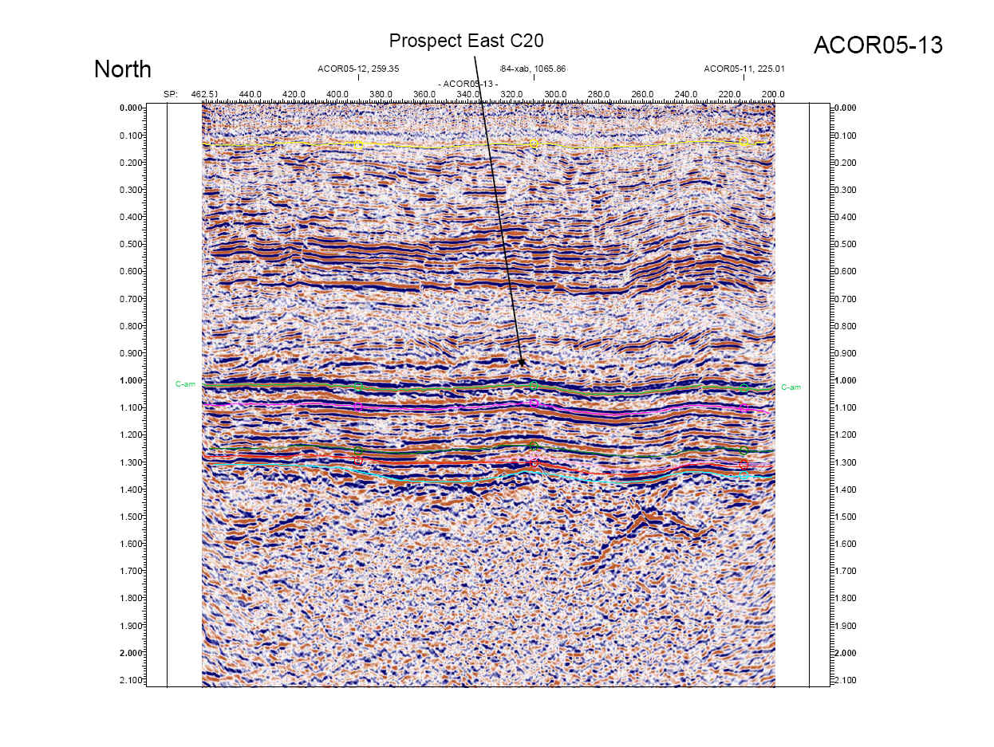
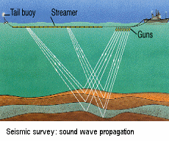
Finding oil - Exploration
Remote sensing
Surface geology
Magnetic survey
Gravity survey
Seismic Survey
EG5066 Energy Technologies: current issues & future directions

Slide 21
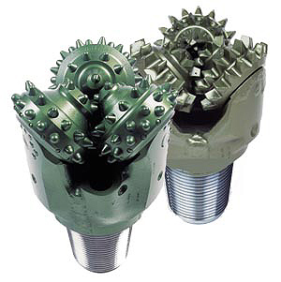
Drilling
Percussive drilling used in Han Dynasty to extract natural gas in Sichuan
Rotary drilling – first use in Texas in 1895, but not dominant until 1950s
Roller-cone drill bits – patent in 1909
“consisted of 2 frusto-conical shaped rollers having longitudinally extending chisel teeth that disintegrate or pulverise the material with which they come in contact and thus form a round hole in said material when the head of the drill revolves”
Major step was development of directional drilling in 1920s
EG5066 Energy Technologies: current issues & future directions

Slide 22
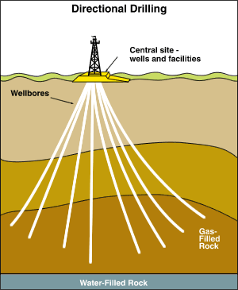
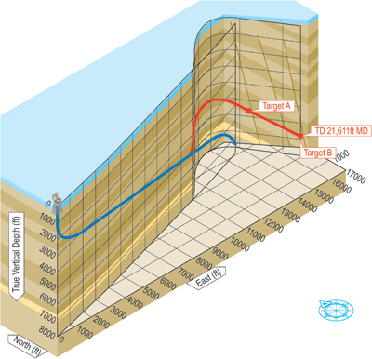
Directional Drilling
Early wells drilled down vertically but started to deviate
10º deviation at 3km depth is 500m off vertical – could be into someone else’s reservoir!
Developed directional drilling
First horizontal drilling in 1920 in Texas – but not commercial success until the 1980s
2-3 times more expensive than vertical wells but can enhance production by 15 – 20 times
Horizontal wells open new production prospects in sandy reservoirs and in formations with water or gas problems or low permeability
EG5066 Energy Technologies: current issues & future directions

Slide 23
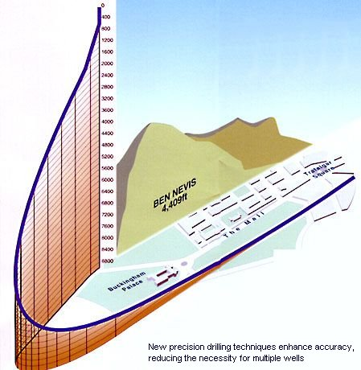
Directional drilling
Multiple wells from artificial sources
Inaccessible locations
Complicated reservoirs
Problem formations (e.g. salt dome drilling)
Sidetracking
Relief wells
EG5066 Energy Technologies: current issues & future directions

Slide 24
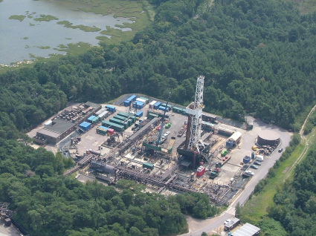
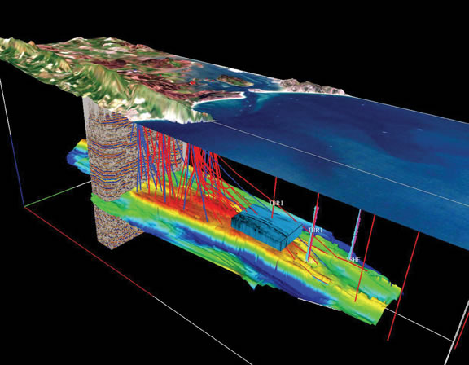
Extended drilling
Extended reach drilling is where the horizontal component is >2x vertical
BP Wytch Farm in Dorset in 1999
Vertical well – 1638m
Horizontal – 10,728m
Goes from land out to reservoir under Poole Bay
EG5066 Energy Technologies: current issues & future directions

Slide 25
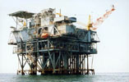
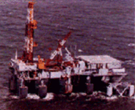
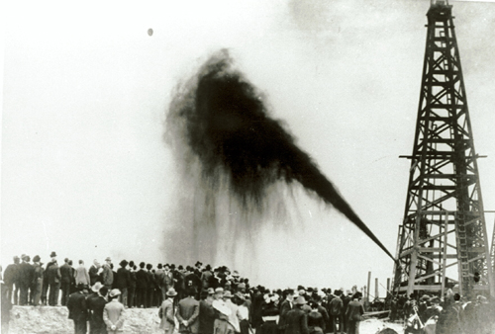
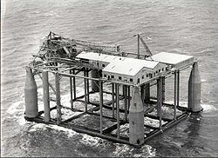
Developments in Drilling Rigs
First Submersible rig Breton Rig 20
1949
First oil well in USA -Drake Oil well, Titusville, Pennsylvania
1859
First offshore well in USA off Southern California in 1897
Mr Charlie Drilling Rig
1953
Spindle top gusher 1907
First semi-submersible Bluewater 1 in Gulf of Mexico 1961
EG5066 Energy Technologies: current issues & future directions

Slide 26
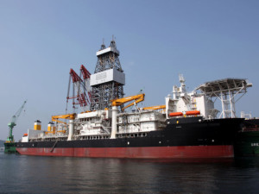
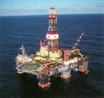
Developments in Drilling Rigs
Discovery class drill ships
Allow drilling in water
Developed in 1970s
By 2006 there were 650 worldwide
Discovery deep seas – 5th generation
Works in ultra-deep waters (>1.5 km (5000 ft)
Jack 2 test well in Gulf of Mexico
282 km offshore
Water 2.1 km deep
Well depth 6 km
Total drilling depth 8.59km
Field estimated at 3 – 15 billion – 50% of US oil reserves!
EG5066 Energy Technologies: current issues & future directions

Slide 27
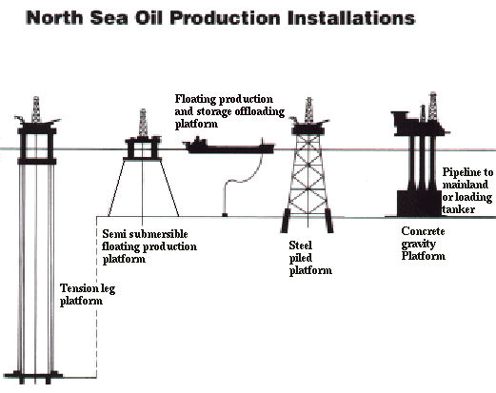
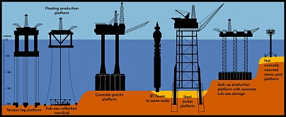
Production Platforms – Offshore Operations
Oil production platform technology developed as operations went into deeper waters. As water depths became greater then move from fixed to floating platforms and now the technology is moving to operations run on the sea floor (subsea) with connection via risers to surface floating vessels. Autonomous systems are the future.
Source: Oil and Gas UK
EG5066 Energy Technologies: current issues & future directions

Slide 28
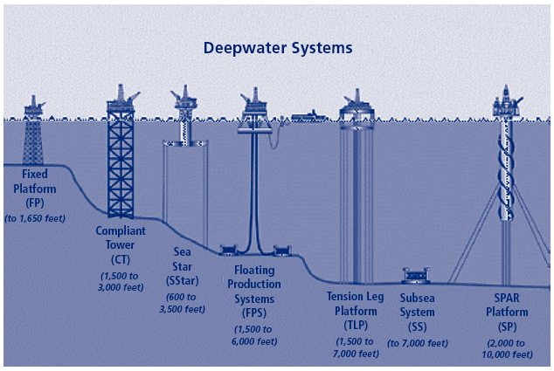
EG5066 Energy Technologies: current issues & future directions

Slide 29
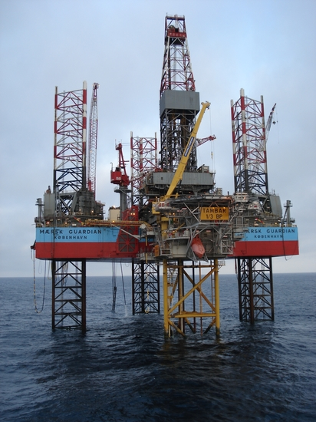
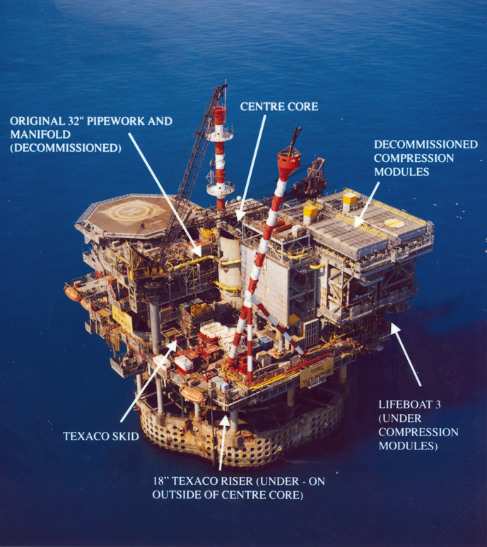
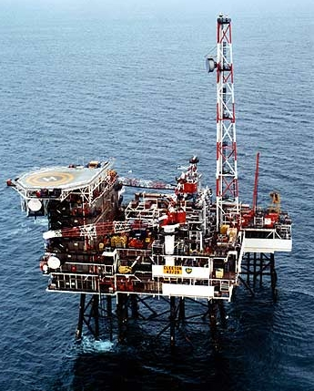
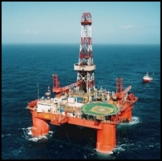
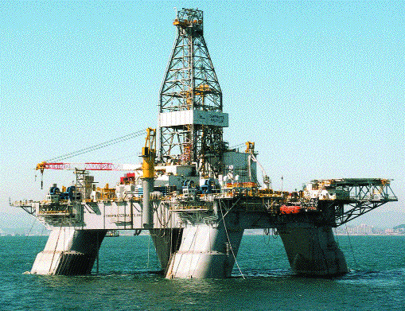
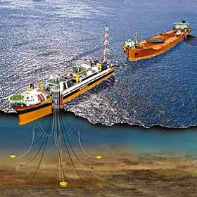
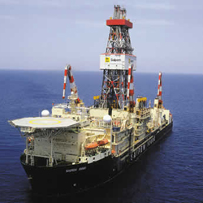
Developments in Drilling Rigs – Offshore Operations
Jack-up rig
Concrete gravity platform
Steel jacket platform
Semi-submersible
modu
Floating Production & Storage
Drill ship
EG5066 Energy Technologies: current issues & future directions

Slide 30


Developments in Drilling Rigs – Offshore Operations
Mars tension-leg platform
Before
After Katrina (2005)
EG5066 Energy Technologies: current issues & future directions

Slide 31

The Oil Well
Oil produced to the surface
Surface casing
Cement
Tubing
Production casing
Packer
Oil enters through perforations
Perforations
EG5066 Energy Technologies: current issues & future directions

Slide 32


Oil Wells
Source: BP
EG5066 Energy Technologies: current issues & future directions

Slide 33


Processing
Gas
Oil
Wellstream
Water
EG5066 Energy Technologies: current issues & future directions

Slide 34


Topside Operations
Offshore production platforms/FPSO collect the hydrocarbons produced under the seabed by means of specially designed flow-lines and risers.
The platform also contains the necessary monitoring & control equipment, and gear for furnishing electric and/or hydraulic power to the subsea equipment installed at the various field wells.
Operations
Well control
Support for well work-over equipment
Separation of gas, oil, water, paraffins/waxes, sand
Support for pumps/compressors required to transport product to shore or re-injection of associated gas back into the well to enhance production
Power generation
Crew accommodation
EG5066 Energy Technologies: current issues & future directions

Slide 35


Technological advances
4D seismic
Directional drilling
Sub-sea facilities
EG5066 Energy Technologies: current issues & future directions

Slide 36




Subsea Operations
EG5066 Energy Technologies: current issues & future directions

Slide 37
Enhanced Oil Recovery
Generic term for techniques for increasing the amount of crude oil that can be extracted from an oil field
Primary & Secondary recovery – 20 – 40%
EOR – 30 – 60%
AKA tertiary oil recovery
Different techniques:
Gas injection – miscible displacement*
Chemical injection – chemical flooding*
Ultrasonic stimulation
Microbial injection
Thermal recovery (cyclic steam, steam flooding, fireflooding)*
EG5066 Energy Technologies: current issues & future directions

Slide 38
Enhanced Oil Recovery
Optimal application depends on:
Reservoir temperature
Pressure
Depth
Permeability
Residual oil and gas saturation
Porosity
Oil API gravity
Oil viscosity
EG5066 Energy Technologies: current issues & future directions

Slide 39

Enhanced Oil Recovery – Gas injection
Most common method
A gas injected into the oil-bearing stratum under high pressure
Pressure pushes the oil into the pipe and to the surface
Method sometimes aids recovery by reducing the viscosity of the crude oil as the gas mixed with it
Gases used – CO₂, natural gas, nitrogen
With CO₂ 50 – 66% of gas returns to surface with oil, then separated and re-injected
EG5066 Energy Technologies: current issues & future directions

Slide 40
Enhanced Oil Recovery – Chemical Injection
Several methods proposed:
Injection of polymers
Either to reduce the crude oil’s viscosity
Or increase the viscosity of water injected to force oil out
Surfactants (such as petroleum sulphonates or biosurfactants such as rhamnolipds) to lower the interfacial pressure or capillary pressure impeding oil droplets moving through the reservoir
Application limited by cost of chemicals and their loss by adsorption onto rock formation
EG5066 Energy Technologies: current issues & future directions

Slide 41
Enhanced Oil Recovery
Ultrasonic stimulation
Use high-powered ultasonic vibrations from a piezoelectric vibration unit lowered into the drillhead to shake the oil droplets from the rock matrix
Microbial injection
Strains of microbes discovered & developed (GM) which:
Partially digest long hydrocarbon molecules
Generate biosurfactants
Emit carbon dioxide and then act like gas injection technique
Not much used as rather expensive
Used in Beverly Hills Oil Field, California
EG5066 Energy Technologies: current issues & future directions

Slide 42
Enhanced Oil Recovery
Thermal Recovery
Crude oil heated to reduce its viscosity and increase the flow – different techniques used to improve seep efficiency & displacement efficiency:
Cyclic steam injection
Steam drive
In situ combustion
Solar thermal EOR
Uses concentrated solar power to produce steam
Used during day, natural gas at night
Replaces 20% of natural gas used for EOR in California.
Example plants:
McKittric, California
Coalinga, California (29MW solar to steam)
Oman
EG5066 Energy Technologies: current issues & future directions

Slide 43

Enhanced Oil Recovery
Encana run Weyburn Oil Field in southern Skatchewan, Canada
A CO₂-EOR project
Projected to inject net 18 million tonnes of CO₂
Recover an additional 130 million barrels of oil
Extending life of field by 25 years
EG5066 Energy Technologies: current issues & future directions

Slide 44

Oil refining
EG5066 Energy Technologies: current issues & future directions

Slide 45


Oil Distillation
Petroleum gases
Light distillate (70 – 200ºC)
Medium distillate (200 – 350ºC)
Feed in
Heavy distillate (>350ºC)
Distillation curve
Residual fractions
EG5066 Energy Technologies: current issues & future directions

Slide 46
Oil Distillation
Gas
20ºC
150ºC
Gasoline
200ºC
Kerosene
300ºC
Diesel oil
Crude oil
Furnace
370ºC
Fuel oil
400ºC
Lubricating oil
Paraffin Wax
Asphalt
EG5066 Energy Technologies: current issues & future directions

Slide 47
Oil Refining
Major products – three main categories:
Light distillates (LPG, gasoline, naphtha)
Middle distillates (kerosene, diesel)
Heavy distillates and residuum (heavy fuel oil, lubricating oils, wax, tar)
Main products
Liquid petroleum gas (LPG)
Gasoline (petrol)
Naphtha
Kerosene and related jet aircraft fuels
Diesel fuel
Lubricating oils
Paraffin wax
Asphalt & tar
Petroleum coke
EG5066 Energy Technologies: current issues & future directions

Slide 48
Oil Distillation
Fraction | Temperature | Fuel type
Light | 7- 200ºC | Petrol Jet fuel Kerosene Feedstock for petrochemicals
Middle | 200 – 350ºC | Diesel fuel Gas oil
Heavy | >350ºC | Marine diesel Fuel oil
Residuals |  | Paraffin waxes Lubricating oils Bitumen for road making Petroleum coke
EG5066 Energy Technologies: current issues & future directions

Slide 49
Refinery Operations
Fractionation (distillation)
Separation of crude oil in atmospheric and vacuum distillation towers into groups of hydrocarbon compounds or differing boiling-point ranges – “fractions” or “cuts”
Light oil processing
Prepares light distillates through rearrangement of molecules using isomerization and catalytic reforming or combination processes such as alkylation and polymerization
Heavy oil processing
Changes the size and/or structure of hydrocarbon molecules through thermal or catalytic cracking processes
Treatment and environmental protection processes
Chemical or physical separation such as dissolving, absorption or precipitation
EG5066 Energy Technologies: current issues & future directions

Slide 50
Refining
Fractionation
Fuel gas
Petrochemical feedstock
Gas Fractionation
Polymerization
Gas & Gasoline
Propane
Butane
Liquid petroleum gases
Gas/hydrogen
Alkylation
Catalytic reforming
Gas/Gasoline
Motor spirit, gasoline
Naptha
Pentane +
Gasoline
Crude oil
Kerosene
Heating oils
Paraffin
Diesel fuel oil
Aviation fuel
Gas oil
Catalytic cracking
Gas oil residue
Heavy fuel oils
Vacuum distillation
Hydro cracking
Asphaltic residue
Heavy fuel oil
Vacuum distillation
Heavy gas oil
Asphalts
Bottom residue
Heavy gas oil
Vacuum distillation
Lubricating distillates
Solvent refining
Lubrication oils, waxes
EG5066 Energy Technologies: current issues & future directions

Slide 51
Fuel Processing
Gas recovery
Burner fuel
LPG
Petrochemicals
(Plastics/Fibres
Atmospheric Distillation
MTBE
Alkylation
Naptha
Hydro-treating
Gasoline
Crude Oil
Catalytic Reforming
Jet/Kerosene
Diesel
Jet/Kerosene
Diesel
Heating Oil
Atmospheric gas oil
Hydrocracking
Vacuum Distillation
Lubes processing
Lubricants
Vacuum gas oil
Hydro-treating
Fluid Catalytic Cracking
Coking
Petroleum Coke
Asphalt
Power Generation
& Marine Fuel
EG5066 Energy Technologies: current issues & future directions

Slide 52
Petrochemicals from Petroleum
Hydrogen
Ammonia
Ammonium sulphate
Fertilisers
Methanol
Urea formaldehyde
Plastics & adhesives
Natural gas
Ethane
Ethylene
Polyethylene
Ethanol
Chemicals
Styrene
Plastics & adhesives
Naptha
Benzene
Insecticides
Cyclohexane
Xylene
Polyesters
Synthetic fibres
Paints, varnishes
Toluene
Phenols
Plastics
Butadiene
Synthetic rubber
Chemicals
Propylene
Acetone
Plastics, synthetic fibres
EG5066 Energy Technologies: current issues & future directions

Slide 53
Typical Yield from a Barrel of Oil
Product | USA | Europe/Asia
Propane/butane | 10% | 10%
Gasoline | 50% | 25%
Jet fuel | 10% | 10%
Diesel/heating oil | 25% | 40%
Heavy fuel oil | 5% | 15%
Source: Exxonmobil
EG5066 Energy Technologies: current issues & future directions

Slide 54
Oil Refinery Capacity
(Thousands of barrels per day)
Region | 1980 | 1990 | 2000 | 2010
N America | 21982 | 19195 | 19937 | 21008
S & Central America | 7251 | 6009 | 6271 | 6653
Europe & Eurasia | 32136 | 27808 | 25278 | 24435
Middle East | 3528 | 5260 | 6491 | 7923
Africa | 2102 | 2804 | 2897 | 3192
Asia Pacific | 12364 | 13470 | 21468 | 28405
World | 79363 | 74546 | 82352 | 91616
China | 1805 | 2892 | 5407 | 10302
India | 557 | 1122 | 2219 | 3703
EG5066 Energy Technologies: current issues & future directions

Slide 55
Oil Refineries throughput
(Thousands of barrels per day)
Region | 1980 | 1990 | 2000 | 2010
North America | 16503 | 16483 | 18195 | 17740
S & Central America | 5249 | 4301 | 5324 | 4615
Europe & Eurasia | 24398 | 22689 | 19202 | 19624
Middle East | 2427 | 4470 | 5430 | 6484
Africa | 1439 | 2171 | 2188 | 2457
Asia Pacific | 9227 | 11184 | 18083 | 24263
World | 59243 | 61297 | 68424 | 75188
China | 1510 | 2153 | 4218 | 8571
India | 502 | 1038 | 2039 | 3899
EG5066 Energy Technologies: current issues & future directions

Slide 56
EG5066 Energy Technologies: current issues & future directions

Slide 57


Natural Gas
EG5066 Energy Technologies: current issues & future directions

Slide 58


Natural Gas
History
1000 BC Mount Parnassus, Greece
500 BC China – first to discover and use natural gas. Bamboo shoot pipeline to transport gas which was burnt to desalinate water
100 AD Persia – first recorded use of natural gas in the home
1785 UK – first commercial use to light houses
1803 UK – gas lighting system patented
1812 UK – first gas company founded in London
1821 USA – first well for natural gas in Fredonia, NY – used for house lighting
1826 UK – first gas cooker devised
EG5066 Energy Technologies: current issues & future directions

Slide 59
Natural Gas
Consists primarily of methane (CH₄) but sometimes contains significant quantities of:
Ethane
Propane
Butane
Pentane
And CO₂, nitrogen, helium and H₂S
Found associated with crude oil
Isolated natural gas reservoirs
In coal beds – coal bed methane
As methane clathrates
Created by methanogenic organisms in marshes, bogs and landfills
EG5066 Energy Technologies: current issues & future directions

Slide 60
Natural Gas
Produced commercially from oil fields & natural gas fields
At lower temperatures (shallower depths) more oil than gas
At higher temperatures (deeper) more gas than oil
Deeper you go the purer the natural gas
Sour gas, tight gas, shale gas and coal bed methane
An important fuel source
Major feedstock for fertilisers
A potent greenhouse gas
EG5066 Energy Technologies: current issues & future directions

Slide 61
Components of Natural Gas
Methane (CH₄)
Ethane (C₂H₆)
Propane (C₃H₈)
Normal butane (n-C₄H₁₀)
Isobutane (i-C₄H₁₀)
Pentanes
Acid gases – CO₂, H₂S, mercaptans – methanethiol (CH₃SH) and ethanethiol (C₂H₅SH)
Other gases – Nitrogen (N₂) and Helium (He)
Water – water vapour and liquid water
Some natural gas condensate (aka casinghead gasoline or natural gasoline)
Crude oil
Mercury
EG5066 Energy Technologies: current issues & future directions

Slide 62
Types of Raw Natural Gas Wells
Three types of gas wells:
Crude oil wells – known as associated gas either:
Separate
Dissolved in crude oil
Natural gas from gas wells with little or no oil – known as non-associated gas
Condensate wells produce raw natural gas & very low density liquid hydrocarbon – natural gas condensate
EG5066 Energy Technologies: current issues & future directions

Slide 63
Natural Gas Condensates
A low density mixture or hydrocarbon liquids present as gaseous components in raw natural gas
Condense out if temperature reduced below hydrocarbon dewpoint temperature of raw gas
Each wet gas field has its own unique gas condensate composition:
H₂S
Mercaptans
CO₂
Straight chain alkanes (C₂ – C₁₂)
Cyclohexanes
Aromatics (benzene, toluene, xylenes, ethylbenzene)
EG5066 Energy Technologies: current issues & future directions

Slide 64

Natural Gas Condensates
Separation technique
Raw gas cooled below hydrocarbon dewpoint
Gas condensates condense out
The condensates passed through high pressure separator where water and raw natural gas separated
Condensates passed to lower pressure vessel and flash vaporised
EG5066 Energy Technologies: current issues & future directions

Slide 65

Gas reserves-to-production (R/P) ratios
EG5066 Energy Technologies: current issues & future directions

Slide 66

Distribution of proved gas reserves
EG5066 Energy Technologies: current issues & future directions

Slide 67
Natural Gas - reserves
Country | Gas Reserves 2011 (trillion m³) | Share of world total (%)
Russia | 44.6 | 21.4
Iran | 33.1 | 15.9
Quatar | 25.0 | 12.0
Turkmenistan | 24.3 | 11.7
USA | 8.5 | 4.1
Saudi Arabia | 8.2 | 3.9
UAE | 6.1 | 2.9
World | 208.4
World’s largest gas field
North Field – offshore Qatar - 25 trillion m³ gas in place
2nd largest
South Pars Gas Field, Iran - 8 – 14 trillion m³ in place
EG5066 Energy Technologies: current issues & future directions

Slide 68

Gas production/consumption by region
EG5066 Energy Technologies: current issues & future directions

Slide 69

Gas consumption per capita
EG5066 Energy Technologies: current issues & future directions

Slide 70

Chart of gas prices
EG5066 Energy Technologies: current issues & future directions

Slide 71

Major gas trade movements
EG5066 Energy Technologies: current issues & future directions

Slide 72
Flow Diagram - Natural Gas Processing Plant
Raw Gas
Tail Gas Treating
Scot process
Clauspol process
Others
Condensate to oil refinery
Tail Gas
Incinerator
Condensate and water removal
Waste water
Nitrogen-rich Gas
Acid Gas
Sulphur Unit
Claus process
Elemental Sulphur
Raw Gas
Acid gas removal
Amine treating
Benfield process
PSA Unit
Sulphinol process
Nitrogen Rejection
Cryogenic process
Absorption processes
Adsorption processes
Dehydration
Glycol unit
PSA unit
Mercury Removal
Mol Sieves
Activated carbon
Removes H₂S & CO₂
Gas Pipeline
Ethane
Propane
Butanes
Pentanes
Sweetening units
Merox process
Sulphrex process
Mol sieves
Fractionation Train
De-ethanizer
De-propanizer
De-butanizer
NGL Recovery
Turbo-expander
De-methanizer
Removes mercaptans
EG5066 Energy Technologies: current issues & future directions

Slide 73
Natural Gas
EG5066 Energy Technologies: current issues & future directions

